Slide 1


Intelligence Analysis: Top-Down Part 2
John Beverley
Assistant Professor, University at Buffalo
Co-Director, National Center for Ontological Research
Affiliate Faculty, Institute of Artificial Intelligence and Data Science

Slide 2
Outline
Real Patterns
From Language to Speech Acts
From Speech Acts to Document Acts
Design Pattern Exercise

Slide 3
Outline
Real Patterns
From Language to Speech Acts
From Speech Acts to Document Acts
Design Pattern Exercise

Slide 4

Pattern Recognition
We’re disposed to recognize patterns with our perceptual faculties…

Slide 5


Pattern Recognition
We’re disposed to recognize patterns with our perceptual faculties…
…and with our cognitive faculties…
Photo 51 crystallography image by Rosalind
Double-helix hypothesized by Watson and Crick

Slide 6
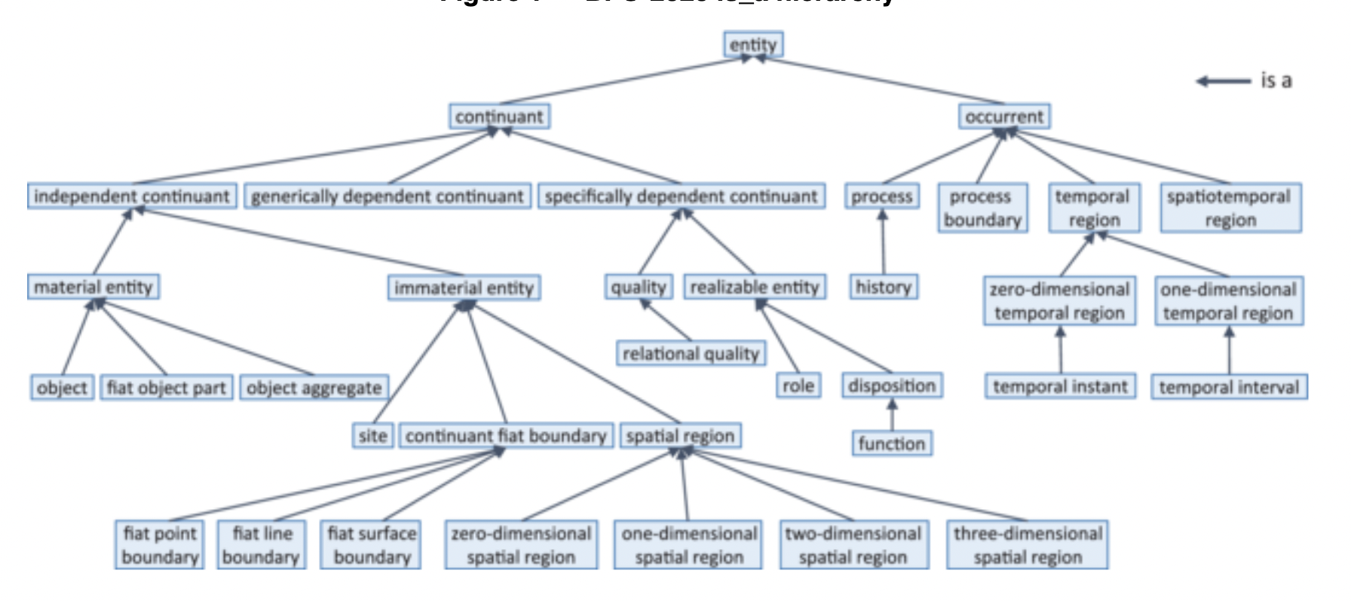
Patterns in Basic Formal Ontology?

Slide 7
BFO 1.0
Earlier versions of BFO did not permit dependent entities to migrate from bearer to bearer
This is true in current versions of BFO for many cases, e.g. your smile is dependent on your face
Dependent entities that cannot migrate fall under the class Specifically Dependent Continuant

Slide 8
Patterns
A need arose to represent dependent entities that could migrate across bearers
This need led to generically dependent continuants, continuants that are in some sense copyable, i.e. patterns
For example, “Snow is white” and “Schnee ist weiß” may be used to express numerically identical content, i.e. the same pattern

Slide 9
Patterns in Basic Formal Ontology

Slide 10
Real Patterns*
X is a real pattern just in case:
X is projectible under at least one physically possible perspective and
X encodes information about at least one structure of events or entities S where that encoding is more efficient, in information-theoretic terms, than the bitmap encoding of S, and where for at least one of the physically possible perspectives under which the pattern is projectible, there exists an aspect of S which cannot be tracked unless the encoding is recovered from the perspective in question.
*Dennett and Ross

Slide 11
Real Patterns*
X is a real pattern just in case:
X is projectible under at least one physically possible perspective and
X encodes information is about at least one entity structure of events or entities S where that encoding is more efficient, in information-theoretic terms, than the bitmap encoding of S, and where for at least one of the physically possible perspectives under which the pattern is projectible, there exists an aspect of S which cannot be tracked unless the encoding is recovered from the perspective in question.
*Loosely inspired by Dennett and Ross

Slide 12
Real Patterns
Some patterns are necessarily about something; some patterns are not
“Snow is white” expresses content that is about snow
“cm” or “.” are not necessarily about anything; they are nevertheless patterns
Most generically dependent entities represented in BFO extensions are patterns that are about something

Slide 13
Aboutness
Information is a pattern that is about something
In BFO extensions - such as the Information Artifact Ontology and the Information Entity Ontology - information is represented by the class Information Content Entity
Where the “is about” relation is understood to be primitive:

Slide 14
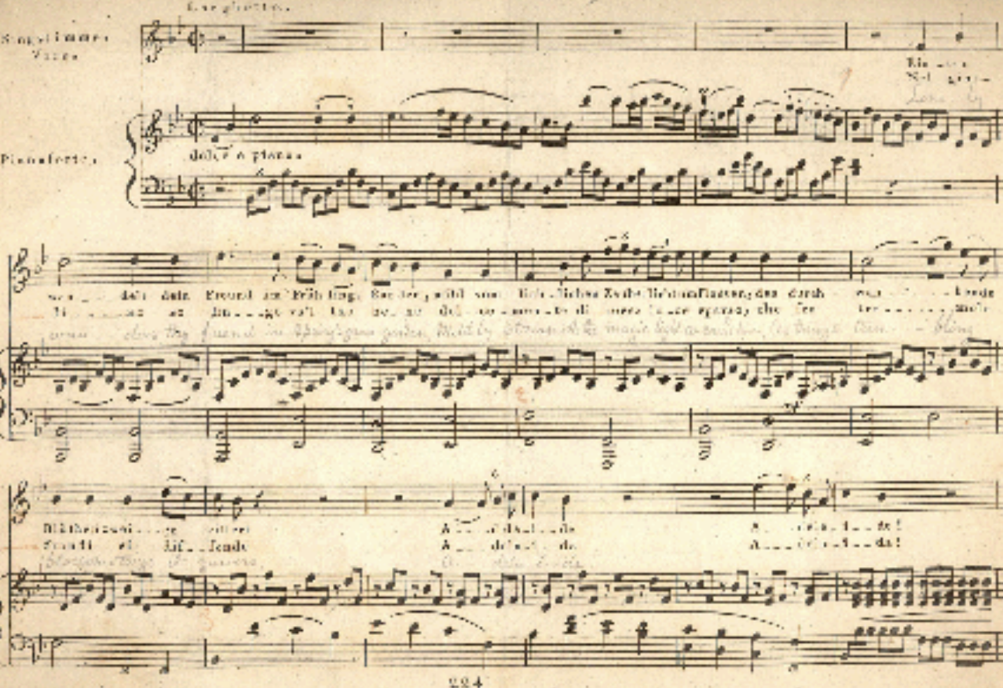
#9 Concretized in Ink Inscription
Information Content
Entity
Specifically Dependent
Continuant
CLASSES
Musical Work
Information
Quality Entity
Ink
Inscription
Symphony
INSTANCES
Beethoven’s #9

Slide 15
Ink Inscription inheres in Parchment
Specifically Dependent
Continuant
Material Entity
CLASSES
Information
Quality Entity
Information
Bearing Entity
Parchment
Ink
Inscription
INSTANCES

Slide 16
#9 Generically Dependent On Parchment
Information Content
Entity
Material Entity
CLASSES
Musical Work
Information
Bearing Entity
Parchment
Symphony
INSTANCES
Beethoven’s #9

Slide 17
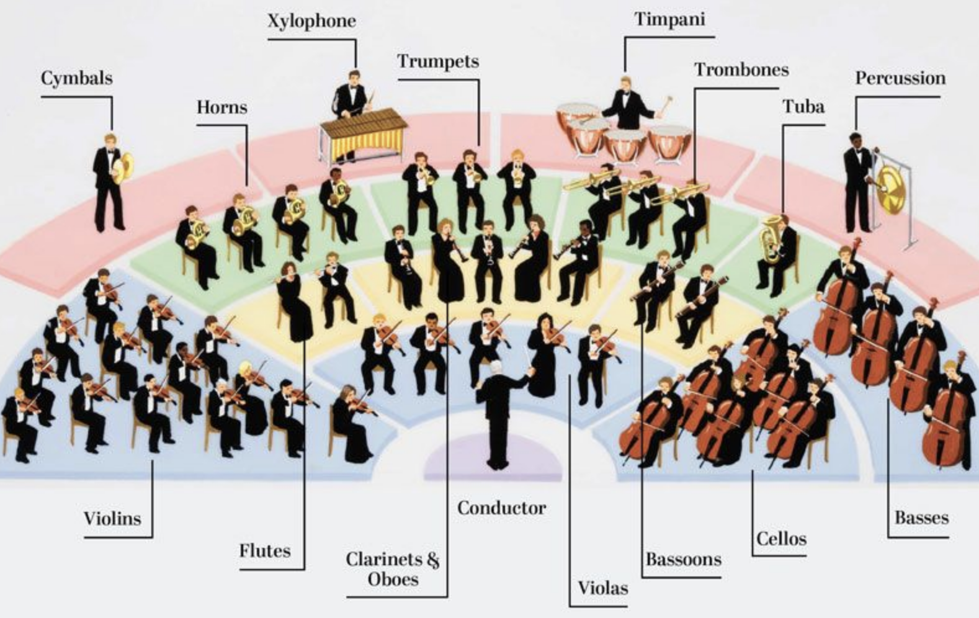
#9 is about Orchestra Plan
Information Content
Entity
Information Content
Entity
CLASSES
Musical Work
Plan Specification
Orchestra Plan
Symphony
INSTANCES
Beethoven’s #9

Slide 18
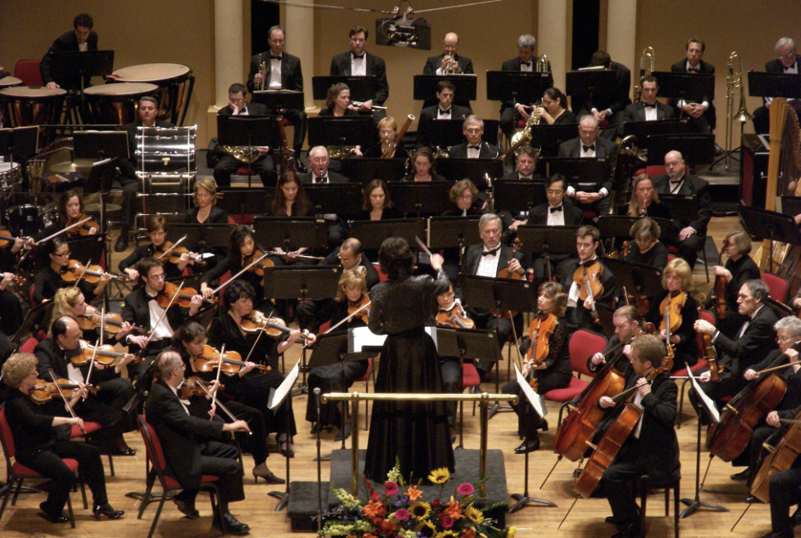
Musician Plan realized in #9 Performance
Disposition
Process
CLASSES
Plan
Planned Process
Musician Plan
#9 Performance
INSTANCES

Slide 19
Beethoven’s #9th Symphony
Beethoven’s #9
is about
generically depends on
concretized
in
concretized in
inheres in
has realization

Slide 20
Outline
Real Patterns
From Language to Speech Acts
From Speech Acts to Document Acts
Design Pattern Exercise

Slide 21
Authority
Many intelligence activities involve government agents and agencies, which have degrees of authority to direct and leverage intelligence
Questions of authority emerge during mission failures and successes, checks and balances, rational historical reconstructions
It is incumbent on us that we explore relationships between intelligence analysis and relevant authority

Slide 22
BFO: Deontic Entities
An adequate account of such deontic entities will require at a minumum ontological characterizations of:
Social dispositions, e.g. customs, languages, rituals, institutions, etc.

Slide 23
BFO: Deontic Entities
An adequate account of such deontic entities will require at a minumum ontological characterizations of:
Social dispositions, e.g. customs, languages, rituals, institutions, etc.
Speech acts, e.g. imperatives, interrogatives, etc.

Slide 24
BFO: Deontic Entities
An adequate account of such deontic entities will require at a minumum ontological characterizations of:
Social dispositions, e.g. customs, languages, rituals, institutions, etc.
Speech acts, e.g. imperatives, interrogatives, etc.
Mental functioning, e.g. beliefs, knowledge, hopes, etc.

Slide 25
BFO: Deontic Entities
An adequate account of such deontic entities will require at a minumum ontological characterizations of:
Social dispositions, e.g. customs, languages, rituals, institutions, etc.
Speech acts, e.g. imperatives, interrogatives, etc.
Mental functioning, e.g. beliefs, knowledge, hopes, etc.
Social acts, e.g. promising, praising, blaiming, etc.

Slide 26
BFO: Deontic Entities
An adequate account of such deontic entities will require at a minumum ontological characterizations of:
Social dispositions, e.g. customs, languages, rituals, institutions, etc.
Speech acts, e.g. imperatives, interrogatives, etc.
Mental functioning, e.g. beliefs, knowledge, hopes, etc.
Social acts, e.g. promising, praising, blaiming, etc.
Documents, e.g. credentials, authorized reports, etc.

Slide 27
BFO: Deontic Entities
An adequate account of such deontic entities will require at a minumum ontological characterizations of:
Social dispositions, e.g. customs, languages, rituals, institutions, etc.
Speech acts, e.g. imperatives, interrogatives, etc.
Mental functioning, e.g. beliefs, knowledge, hopes, etc.
Social acts, e.g. promising, praising, blaiming, etc.
Documents, e.g. credentials, authorized reports, etc.
Authorities, e.g. governments, institutions, etc.

Slide 28
BFO: Deontic Entities
An adequate account of such deontic entities will require at a minumum ontological characterizations of:
Social dispositions, e.g. customs, languages, rituals, institutions, etc.
Speech acts, e.g. imperatives, interrogatives, etc.
Mental functioning, e.g. beliefs, knowledge, hopes, etc.
Social acts, e.g. promising, praising, blaiming, etc.
Documents, e.g. credentials, authorized reports, etc.
Authorities, e.g. governments, institutions, etc.

Slide 29
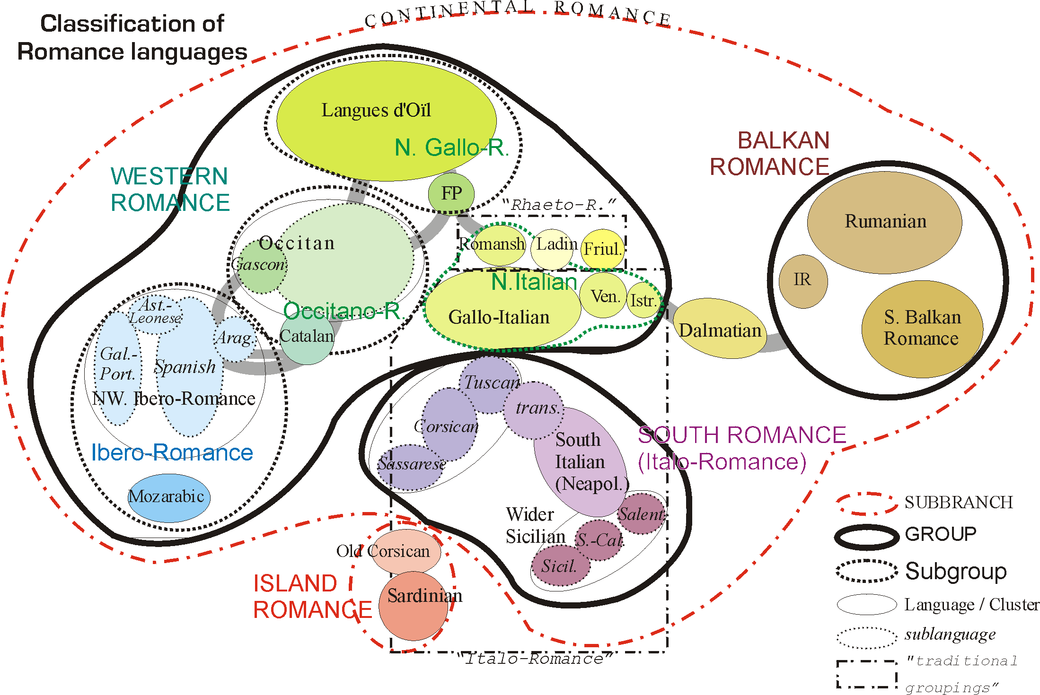
Chomsky on E-Language
"Language" may mean the sociopolitical vernacular that we learn in our communities, i.e. E-language.
E-Language is external, communal, changeable, and may be corrected. For example, the term "livid" means "cold, blue with anger" and yet most people seem to think it means "hot, red with anger."

Slide 30
E-Language as Convention
The languages we speak are governed by conventional rules of grammar, style, and so on.
We are habituated into the use of these rules early on
But ultimately they are conventions like any other, e.g. the reason you don’t into people on a sidewalk
More fundamentally, conventions are a species of regularities, or patterns of behavior

Slide 31
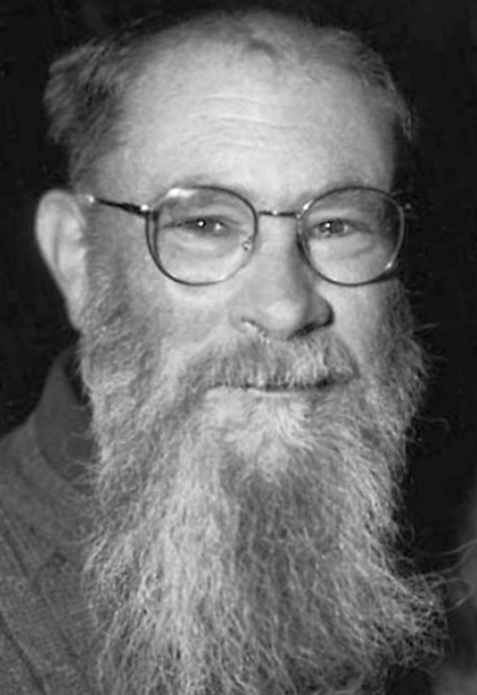
Lewis on Convention
A regularity R is a convention just in case:
Everyone conforms to R
Everyone believes others conform to R
This belief gives everyone a good reason to conform to R himself
Everyone believes others are doing the best they can to conform to R
R is not the only possible regularity meeting (3) and (4)
Each of the preceding factors are in principle common knowledge

Slide 32
Lewis on Convention
“I swam” rather than “I swimmed”
A regularity R is a convention just in case:
Everyone conforms to R
Everyone believes others conform to R
This belief gives everyone a good reason to conform to R himself
Everyone believes others are doing the best they can to conform to R
R is not the only possible regularity meeting (3) and (4)
Each of the preceding factors are in principle common knowledge

Slide 33
Lewis on Convention
“I swam” rather than “I swimmed”
A regularity R is a convention just in case:
Everyone conforms to R
Everyone believes others conform to R
This belief gives everyone a good reason to conform to R himself
Everyone believes others are doing the best they can to conform to R
R is not the only possible regularity meeting (3) and (4)
Each of the preceding factors are in principle common knowledge

Slide 34
Lewis on Convention
“I swam” rather than “I swimmed”
A regularity R is a convention just in case:
Everyone conforms to R
Everyone believes others conform to R
This belief gives everyone a good reason to conform to R himself
Everyone believes others are doing the best they can to conform to R
R is not the only possible regularity meeting (3) and (4)
Each of the preceding factors are in principle common knowledge

Slide 35
Lewis on Convention
“I swam” rather than “I swimmed”
A regularity R is a convention just in case:
Everyone conforms to R
Everyone believes others conform to R
This belief gives everyone a good reason to conform to R himself
Everyone believes others are doing the best they can to conform to R
R is not the only possible regularity meeting (3) and (4)
Each of the preceding factors are in principle common knowledge

Slide 36
Lewis on Convention
“I swam” rather than “I swimmed”
A regularity R is a convention just in case:
Everyone conforms to R
Everyone believes others conform to R
This belief gives everyone a good reason to conform to R himself
Everyone believes others are doing the best they can to conform to R
R is not the only possible regularity meeting (3) and (4)
Each of the preceding factors are in principle common knowledge

Slide 37
Lewis on Convention
“I swam” rather than “I swimmed”
A regularity R is a convention just in case:
Everyone conforms to R
Everyone believes others conform to R
This belief gives everyone a good reason to conform to R himself
Everyone believes others are doing the best they can to conform to R
R is not the only possible regularity meeting (3) and (4)
Each of the preceding factors are in principle common knowledge

Slide 38
Lewis on Convention
“I swam” rather than “I swimmed”
A regularity R is a convention just in case:
Everyone conforms to R
Everyone believes others conform to R
This belief gives everyone a good reason to conform to R himself
Everyone believes others are doing the best they can to conform to R
R is not the only possible regularity meeting (3) and (4)
Each of the preceding factors are in principle common knowledge

Slide 39
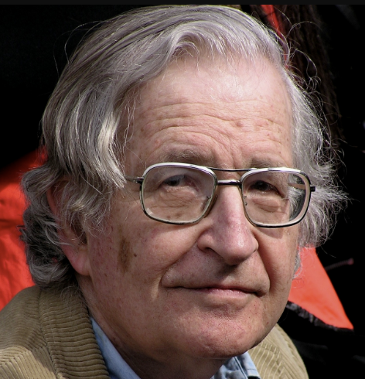
Chomsky on I-Language
"Language" may also mean the internal, innate, unchanging foundation for linguistic competence, e.g. I-Language
Chomsky claimed I-Language was the proper target of linguistics, as it reveals the computational system of the brain

Slide 40
Beverley on I-Logic
Linguistics competence consists of dispositions borne by an agent
There must be an innate competence for logical reasoning since language depends on drawing distinctions
The picture:*
Foundational logic competence (I-Logic) grounds for
Foundational linguistic competence (I-Language) grounds for
Derivative linguistic competence (E-language) grounds for
Derivative logic competence (E-Logic)
* Beverley, Trust Logic, Not Tortoises

Slide 41
BFO: Deontic Entities
An adequate account of such deontic entities will require at a minumum ontological characterizations of:
Social dispositions, e.g. customs, languages, rituals, institutions, etc.
Speech acts, e.g. imperatives, interrogatives, etc.
Mental functioning, e.g. beliefs, knowledge, hopes, etc.
Social acts, e.g. promising, praising, blaiming, etc.
Documents, e.g. credentials, authorized reports, etc.
Authorities, e.g. governments, institutions, etc.

Slide 42

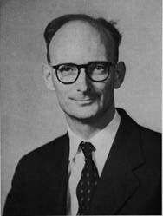
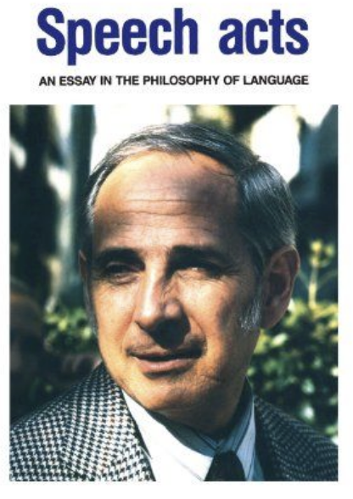
Speech Acts
While speech is any act of uttering, a speech act is an act in which an agent intends to convey meaning that is performed by the act
Example categories of speech act include:
Assertion
Directive
Commissive
Expressive
Declaration

Slide 43
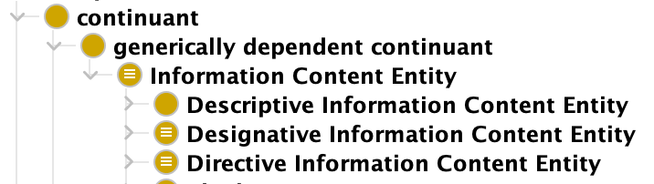
Speech Acts
While speech is any act of uttering, a speech act is an act in which an agent intends to convey meaning that is performed by the act
Example categories of speech act include:
Assertion
Directive
Commissive
Expressive
Declaration
Information Entity Ontology – Common Core Ontologies

Slide 44
Varieties of Fit for Speech Acts
Speech act types can be distinguished in terms of their direction of fit
Word-to-World: Make words fit the world, e.g. descriptive
World-to-Word: Make world fit the words, e.g. directive
Creation-of-Fit: Words change the world, e.g. designative

Slide 45
Varieties of Fit for Speech Acts
Speech act types can be distinguished in terms of their direction of fit
Word-to-World: Make words fit the world, e.g. descriptive
World-to-Word: Make world fit the words, e.g. directive
Creation-of-Fit: Words change the world, e.g. designative

Slide 46
Descriptive ICE
The class of information content entities that describe entities
Such as a collection of demographic data, your biometric measurements, and so on
Descriptive ICE can be evaluated for truth or falsity, e.g. “John is bald” is either true or false

Slide 47
Varieties of Fit for Speech Acts
Speech act types can be distinguished in terms of their direction of fit
Word-to-World: Make words fit the world, e.g. descriptive
World-to-Word: Make world fit the words, e.g. directive
Creation-of-Fit: Words change the world, e.g. designative

Slide 48
Directive ICE
The class of information content entities that prescribe entities
Such as blueprints for an automobile, directions for completing an assignment, algorithms, rules of grammar, and so on
Directive ICE are not evaluable for truth or falsity, e.g. “Close the door” is neither true nor false

Slide 49
Varieties of Fit for Speech Acts
Speech act types can be distinguished in terms of their direction of fit
Word-to-World: Make words fit the world, e.g. descriptive
World-to-Word: Make world fit the words, e.g. directive
Creation-of-Fit: Words change the world, e.g. designative

Slide 50
Designative ICE
The class of information content entities that designate entities
Such as names, artifact identifiers, spatial region codes or identifier, and so on
Designative ICE are often declared to be true, such as when one names a child or the coast of Madagascar; the designation may be appropriate or not

Slide 51
BFO: Deontic Entities
An adequate account of such deontic entities will require at a minumum ontological characterizations of:
Social dispositions, e.g. customs, languages, rituals, institutions, etc.
Speech acts, e.g. imperatives, interrogatives, etc.
Mental functioning, e.g. beliefs, knowledge, hopes, etc.
Social acts, e.g. promising, praising, blaiming, etc.
Documents, e.g. credentials, authorized reports, etc.
Authorities, e.g. governments, institutions, etc.

Slide 52

Social World Ingredients
Performance of speech acts such as promising, asserting, excusing, etc. agents create:
Claims and Obligations
Authorities and Responsibilities
Memberships and Exclusions
Which are ingredients in the ontology of the social world

Slide 53
Claims and Obligations
If Sam promises Sally to perform X, then Sam acquires an obligation to perform X
Similarly, Sally acquires a claim on Sam that he perform X
The claim and obligation are mutually dependent, i.e. mutually specifically dependent roles

Slide 54
Claims and Obligations in BFO
As with other roles in BFO, claims and obligations are underwritten by the dispositions of the parties involved
Sam’s obligation is grounded in:
dispositions inhering in Sally
Or dispositions inhering in the wider society
To hold Sam accountable (e.g. punish, shame, shun, scold, etc.) if he fails to perform X as promised

Slide 55
Outline
Real Patterns
From Language to Speech Acts
From Speech Acts to Document Acts
Design Pattern Exercise

Slide 56
BFO: Deontic Entities
An adequate account of such deontic entities will require at a minumum ontological characterizations of:
Social dispositions, e.g. customs, languages, rituals, institutions, etc.
Speech acts, e.g. imperatives, interrogatives, etc.
Mental functioning, e.g. beliefs, knowledge, hopes, etc.
Social acts, e.g. promising, praising, blaiming, etc.
Documents, e.g. credentials, authorized reports, etc.
Authorities, e.g. governments, institutions, etc.

Slide 57
From Speech Acts to Document Acts
Documents can be:
Copied, modified, stored
Aggregated, e.g. appendices
Have component parts, e.g. plans have sub-plans
Executable, e.g. code
Documents, combined with authority, make possible collective agency in corporations, universities, religions, governments, legal codes, armies, etc.

Slide 58
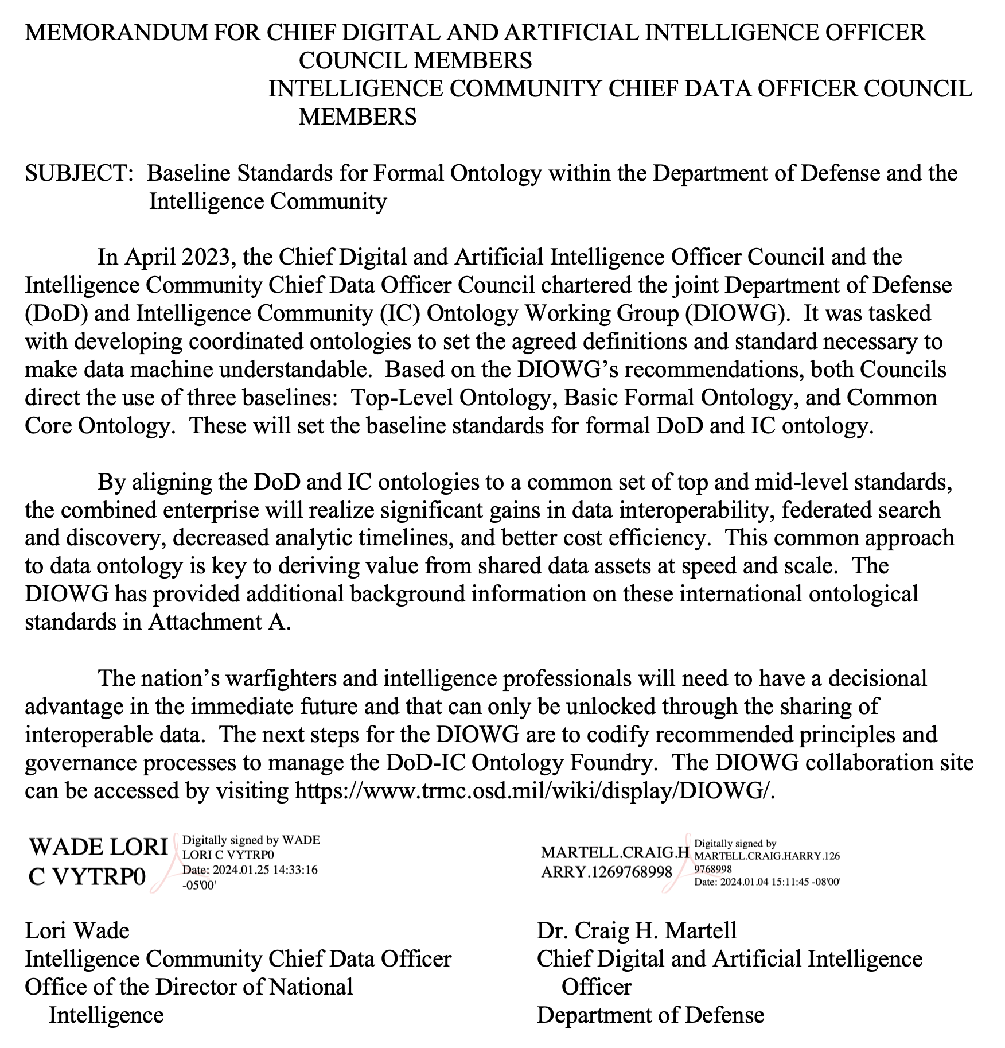
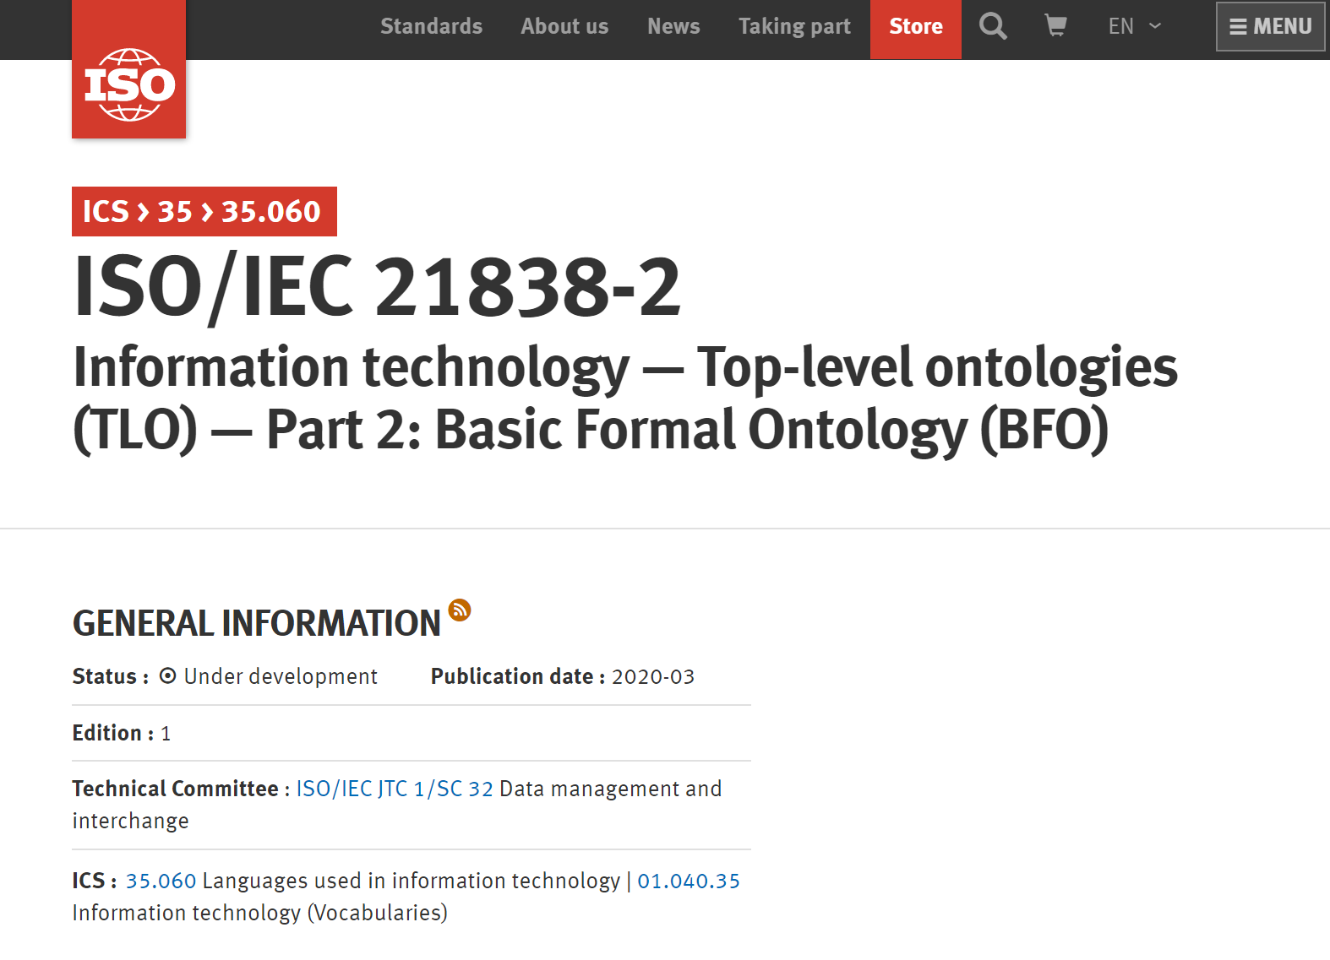

Slide 59
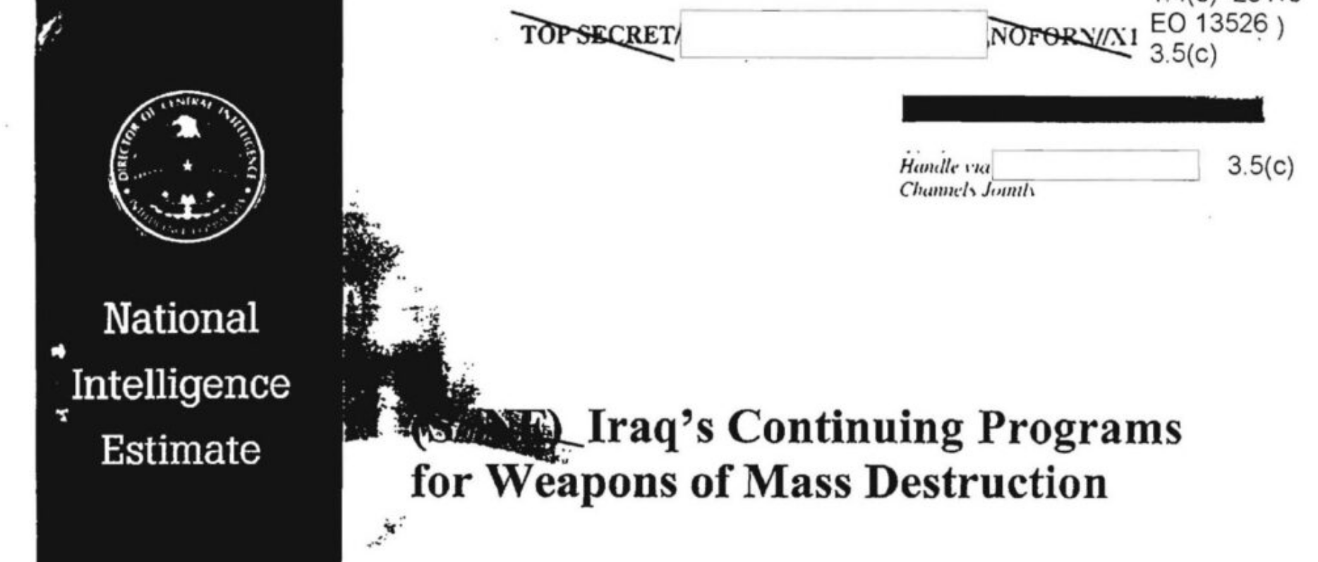

Slide 60
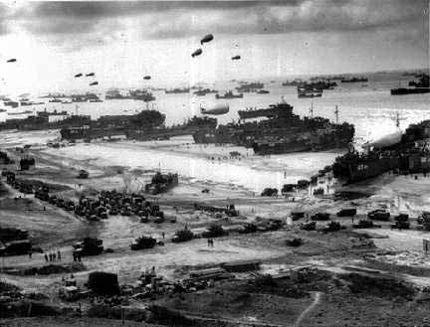
D-Day Landings
Notes:
http://www.google.com/imgres?um=1&hl=en&tbo=d&biw=1366&bih=610&tbm=isch&tbnid=xvBuU3znJmnzLM:&imgrefurl=http://www.rjgeib.com/heroes/draper/german-point-of-view.html&docid=__bCJ0XzNrdPlM&imgurl=http://www.rjgeib.com/heroes/draper/d-day-beach.jpg&w=432&h=329&ei=fjfDUL-1O5HssgbSmoDYAg&zoom=1&iact=rc&dur=578&sig=112516764352206821928&page=1&tbnh=136&tbnw=198&start=0&ndsp=18&ved=1t:429,r:2,s:0,i:156&tx=54&ty=87

Slide 61


Slide 62
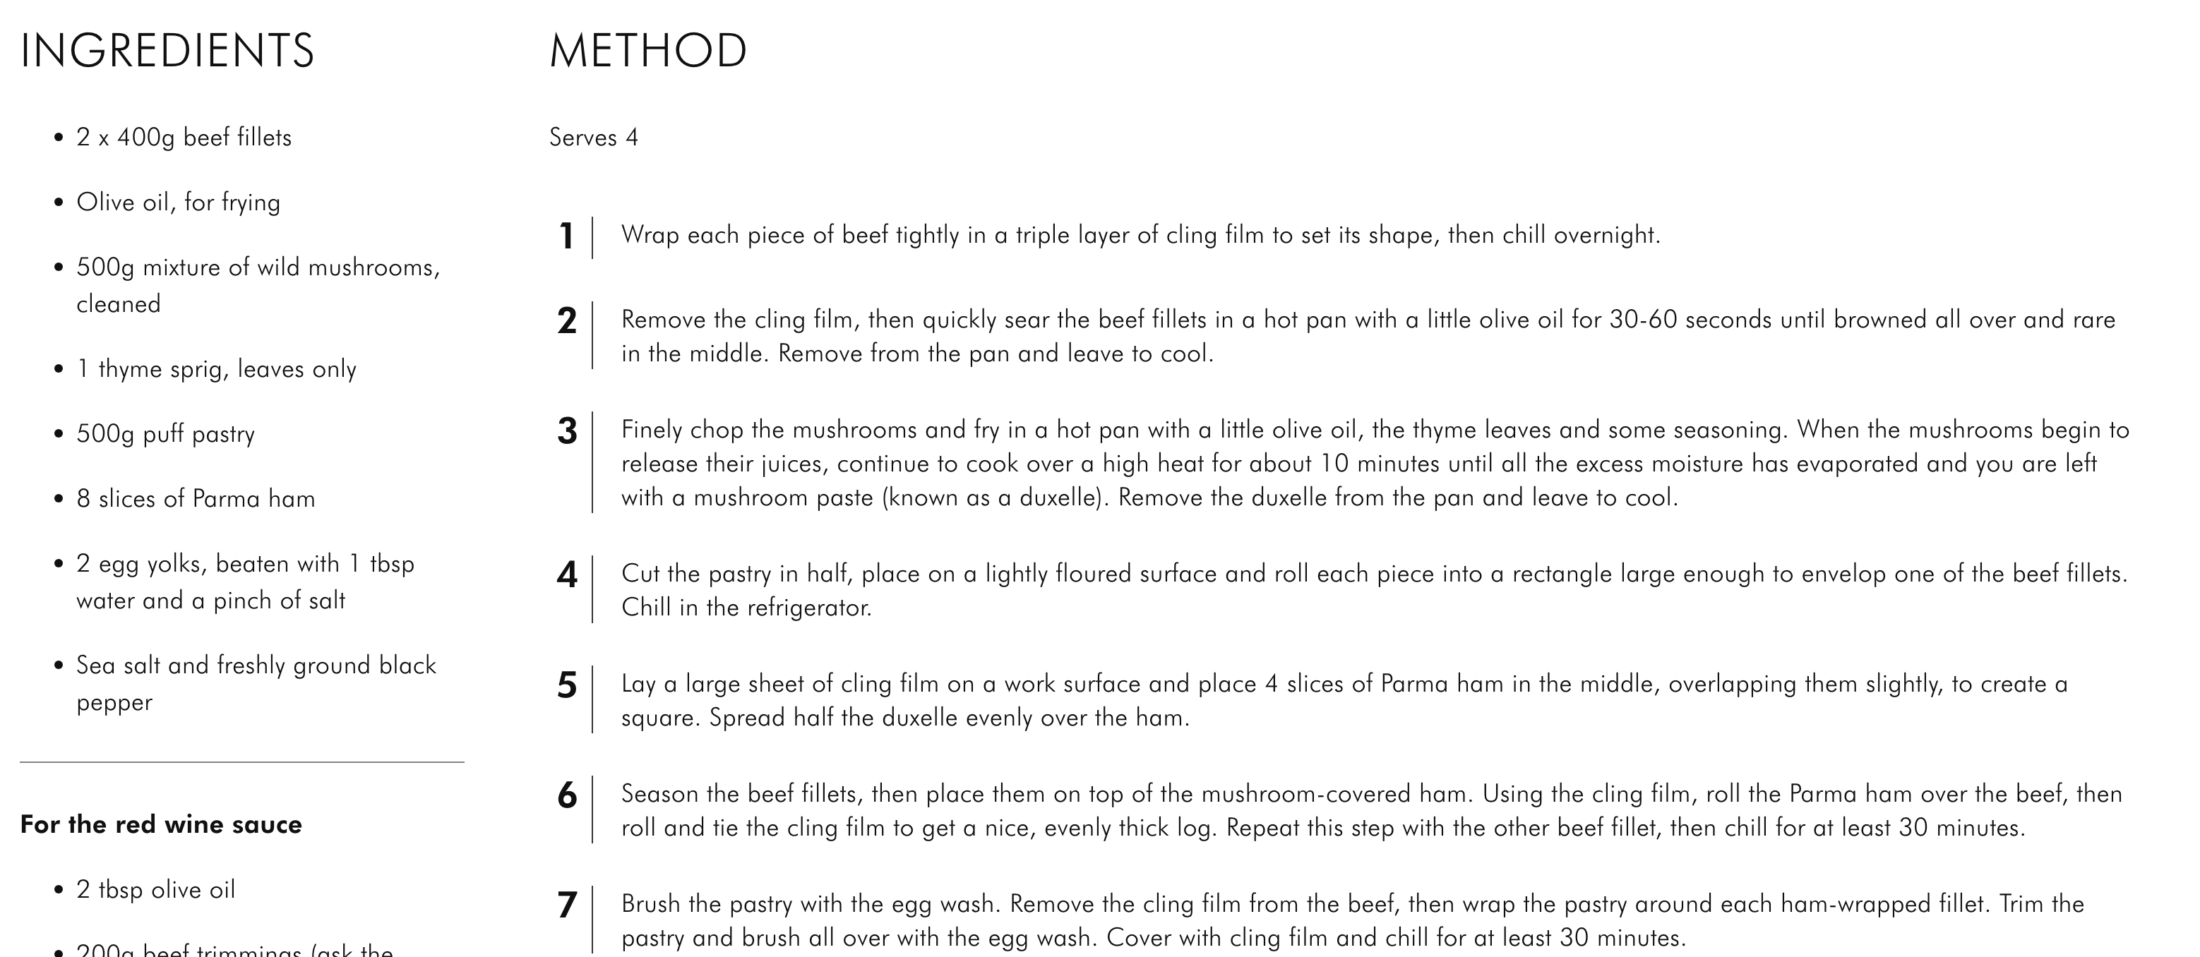

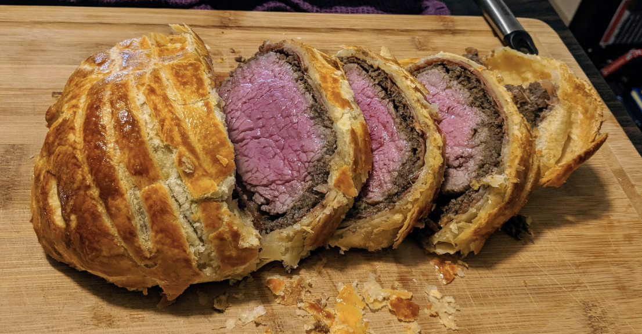

Slide 63




Digital Documention
Documentation created a new dimension of economic reality:
Bank accounts
Mortgages
Stocks and Options
Cryptocurrency
Credit Cards
Which are enduring social networks
Debts and credits become information entities analogous to digital artifacts

Slide 64




Digital Documention
Documentation created a new dimension of social reality:
Online profiles
Digital galleries
Tweets
Live feeds
Online forums
Which are also enduring social networks
Online presences becomes information entities analogous to digital artifacts

Slide 65

Social Reality
Standardized and digital document play a crucial role in supporting and progressing the modern social world
And much like a promise creates an obligation and a claim, so too documents create rights, obligations, responsibilities, etc.

Slide 66
Document Act Theory
Expanding speech act theory to document act theory has as its scope the social and institutional powers of documents, whether deontic, legal, etc.
Like speech act theory, such a theory concerns how to do things with documents:
Represent the ways things are
Prescribe others to do things
Commit ourselves to doing things
Change the world

Slide 67

Varieties of Fit for Documents Acts
Document act types can be distinguished in terms of their direction of fit:
World-to-Document: Plan created so world fits the plan, e.g. blueprint
Document-to-World: Report describes plan execution, e.g. evaluation
Standardization-of-Fit: Authority publishes rule, e.g. legislation

Slide 68
Varieties of Fit for Documents Acts
Document act types can be distinguished in terms of their direction of fit:
World-to-Document: Plan created so world fits the plan, e.g. blueprint
Document-to-World: Report describes plan execution, e.g. evaluation
Standardization-of-Fit: Authority publishes rule, e.g. legislation

Slide 69
“Documents and document systems are the mechanisms for creating the institutional orders of Western capitalism.”
* de Soto, The Mystery of Capital: Why Capitalism Triumphs in the West and Fails Everywhere Else

Slide 70
Varieties of Fit for Documents Acts
Document act types can be distinguished in terms of their direction of fit:
World-to-Document: Plan created so world fits the plan, e.g. blueprint
Document-to-World: Report describes plan execution, e.g. evaluation
Standardization-of-Fit: Authority publishes rule, e.g. legislation

Slide 71
“It is a profoundly erroneous truism, repeated by all copy-books and by eminent people when they are making speeches, that we should cultivate the habit of thinking what we are doing. The precise opposite is the case. Civilization advances by extending the number of important operations which we can perform without thinking about them.”
* Whitehead, An Introduction to Mathematics

Slide 72
Varieties of Fit for Documents Acts
Document act types can be distinguished in terms of their direction of fit:
World-to-Document: Plan created so world fits the plan, e.g. blueprint
Document-to-World: Report describes plan execution, e.g. evaluation
Standardization-of-Fit: Authority publishes rule, e.g. legislation

Slide 73
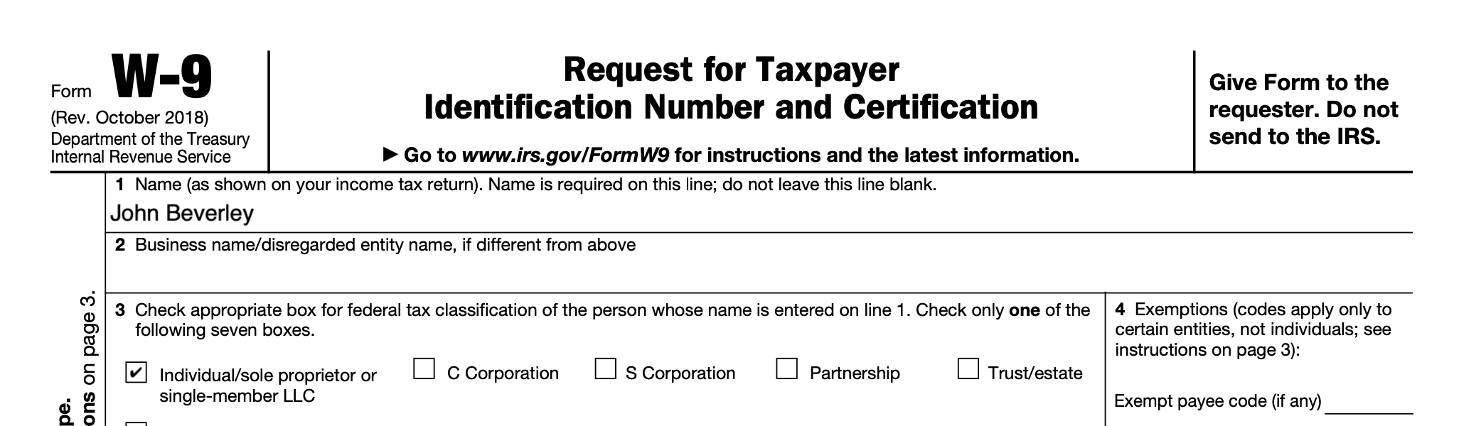
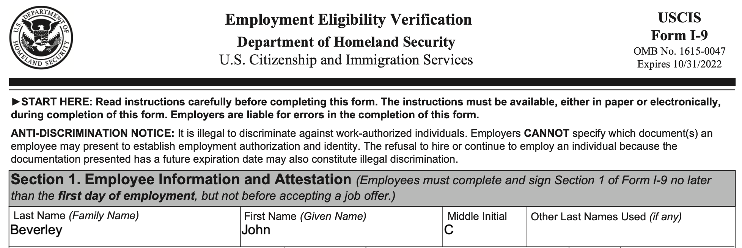
Standardized Documentation
Allow for standardized transactions, improved communication
Allow assets to be described in standard, stable, categories
Supports transition to robust registries

Slide 74
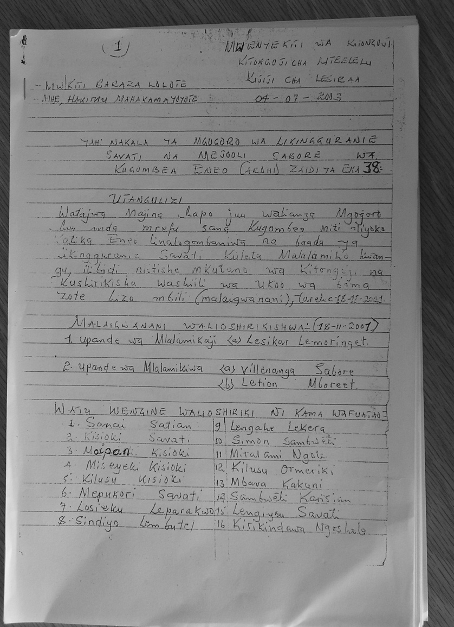
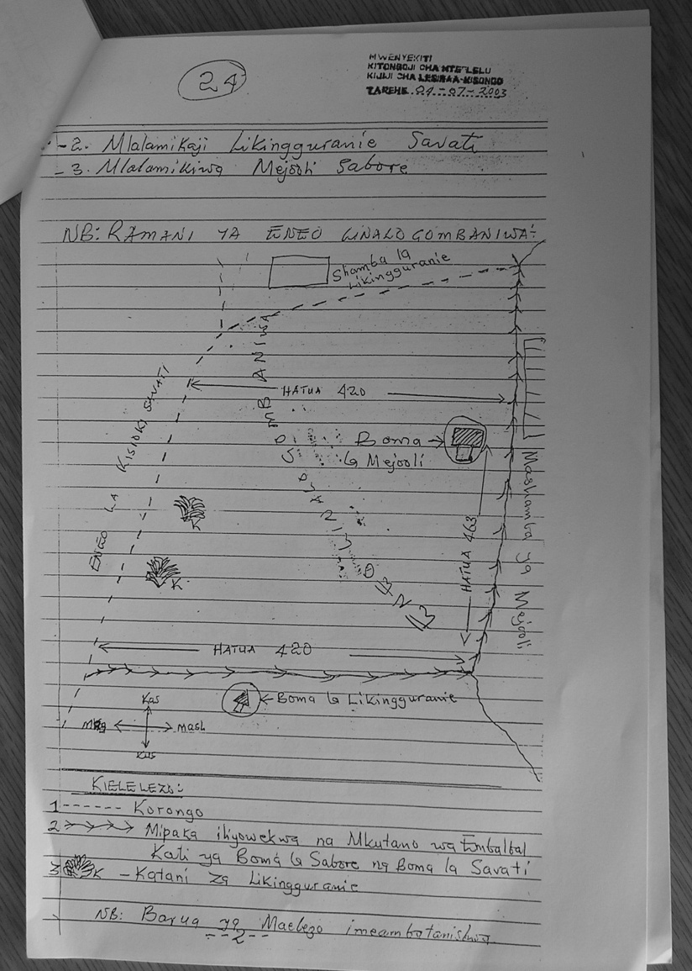
Property Rights
Property differs from a mere piece of land in that property is associated with documentation that creates and establishes rights which tie the owner to a physical asset
Documentation of property dispute
resolution over land in the Arusha area;
established property rights

Slide 75

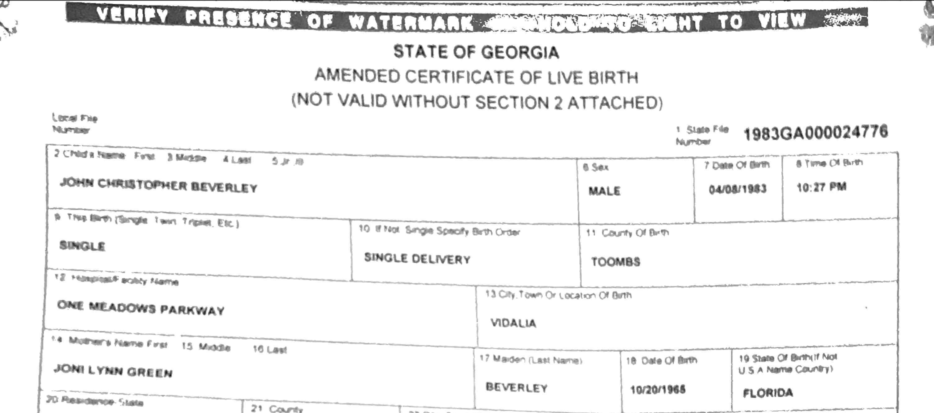
Vital Records
These documents create and bind
social and institutional reality
Vital records offices oversees curation of and ways in which records may be subjected to amendment

Slide 76
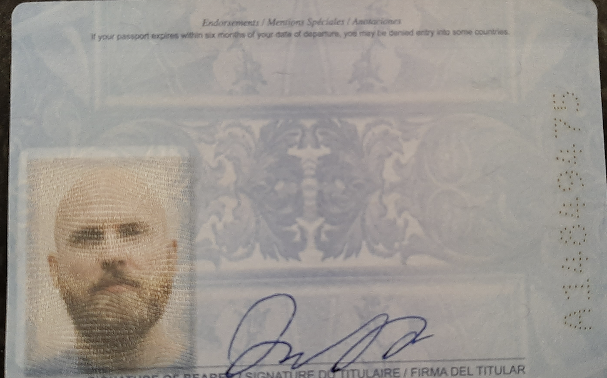
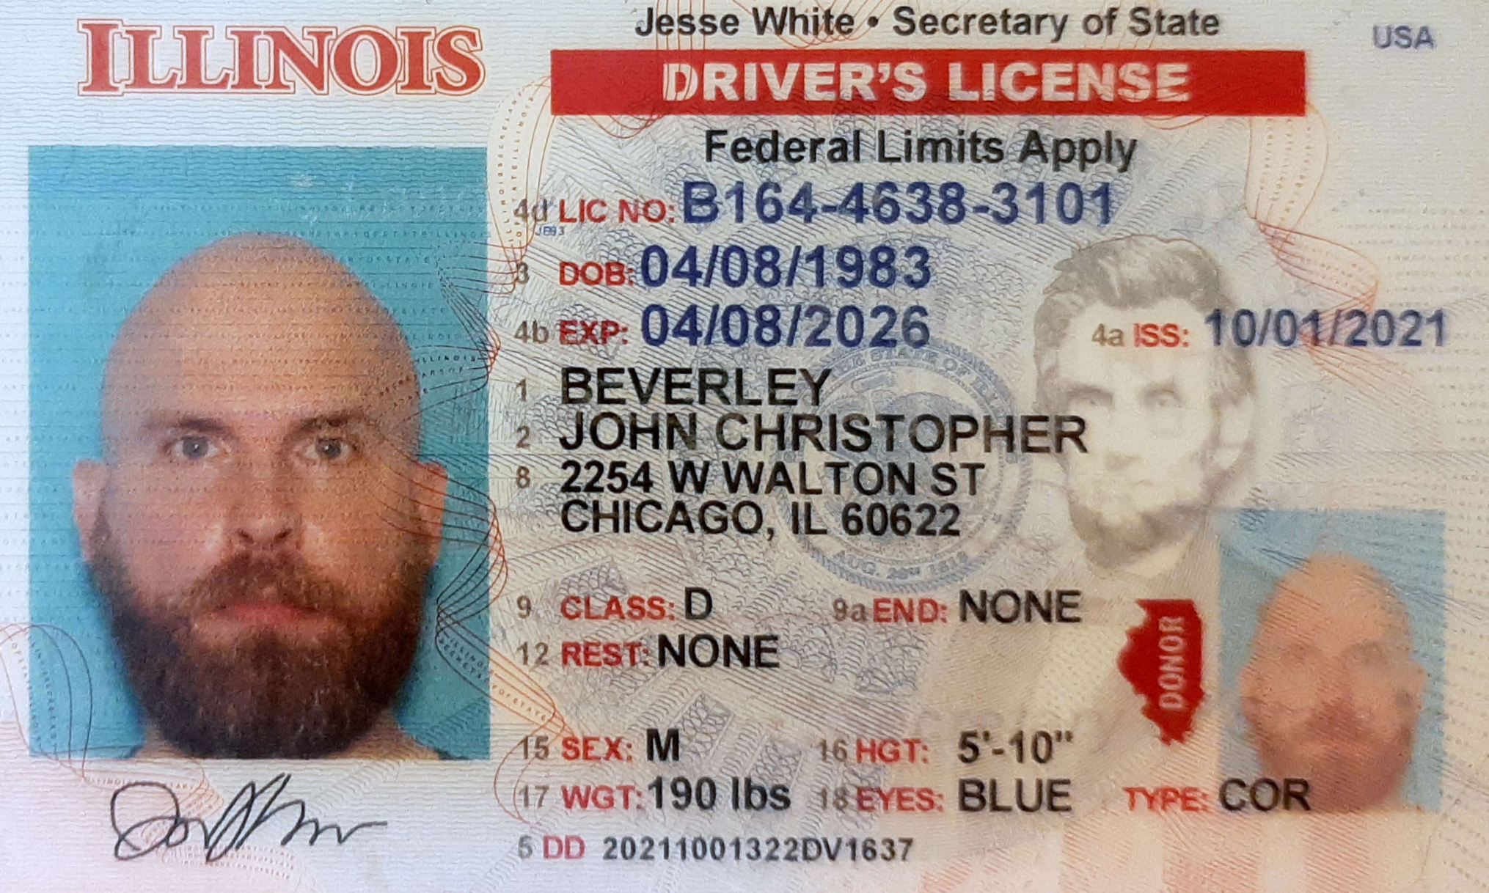

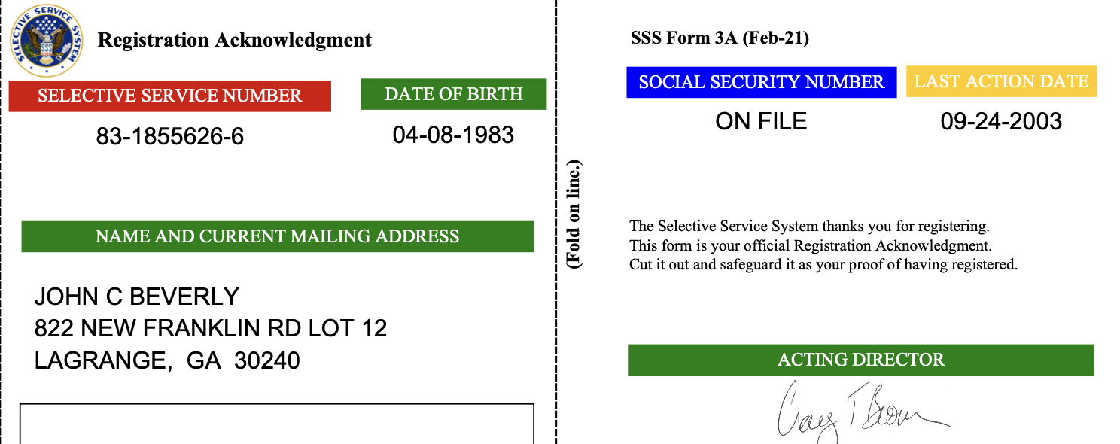
Credentials
Credentials are a type of standardized document which:
Serve as a status indicator
Are institutional objects
Credentials enable rights-holders to exercise rights, assuming the holder is able to display the appropriate documentation

Slide 77
BFO: Deontic Entities
An adequate account of deontic entities will require at a minumum ontological characterizations of:
Social dispositions, e.g. customs, languages, rituals, institutions, etc.
Speech acts, e.g. imperatives, interrogatives, etc. (see ARGO)
Mental functioning, e.g. beliefs, knowledge, hopes, etc. (see MFO)
Social acts, e.g. promising, praising, blaiming, etc.
Documents, e.g. credentials, authorized reports, etc. (see D-Acts)
Authorities, e.g. governments, institutions, etc. (see CCO)
green indicates developed work; blue indicates first steps; red indicates gap

Slide 78
Outline
Real Patterns
From Language to Speech Acts
From Speech Acts to Document Acts
Design Pattern Exercise

Slide 79
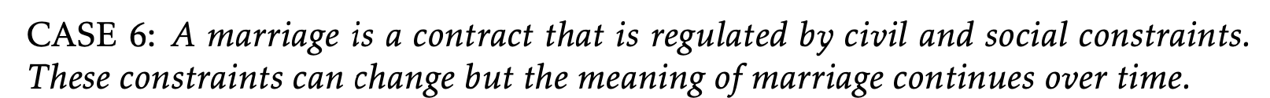

Slide 80
Case Study: Marriage License
In the U.S., states impose eligibility requirements on individuals, e.g. individuals entering marriage must be able to consent and above a certain age.
States also impose eligibility requirements on the couple, e.g. one member of the union must be a U.S. citizen

Slide 81
Case Study: Marriage License
Before 1967, several states prohibited interracial marriage; until 2015 several prohibited same-sex marriage.
Governments grant obligations to spouses - married partners bear financial responsibilities to one another - and privileges - married partners are not required to testify against one another in court.

Slide 82
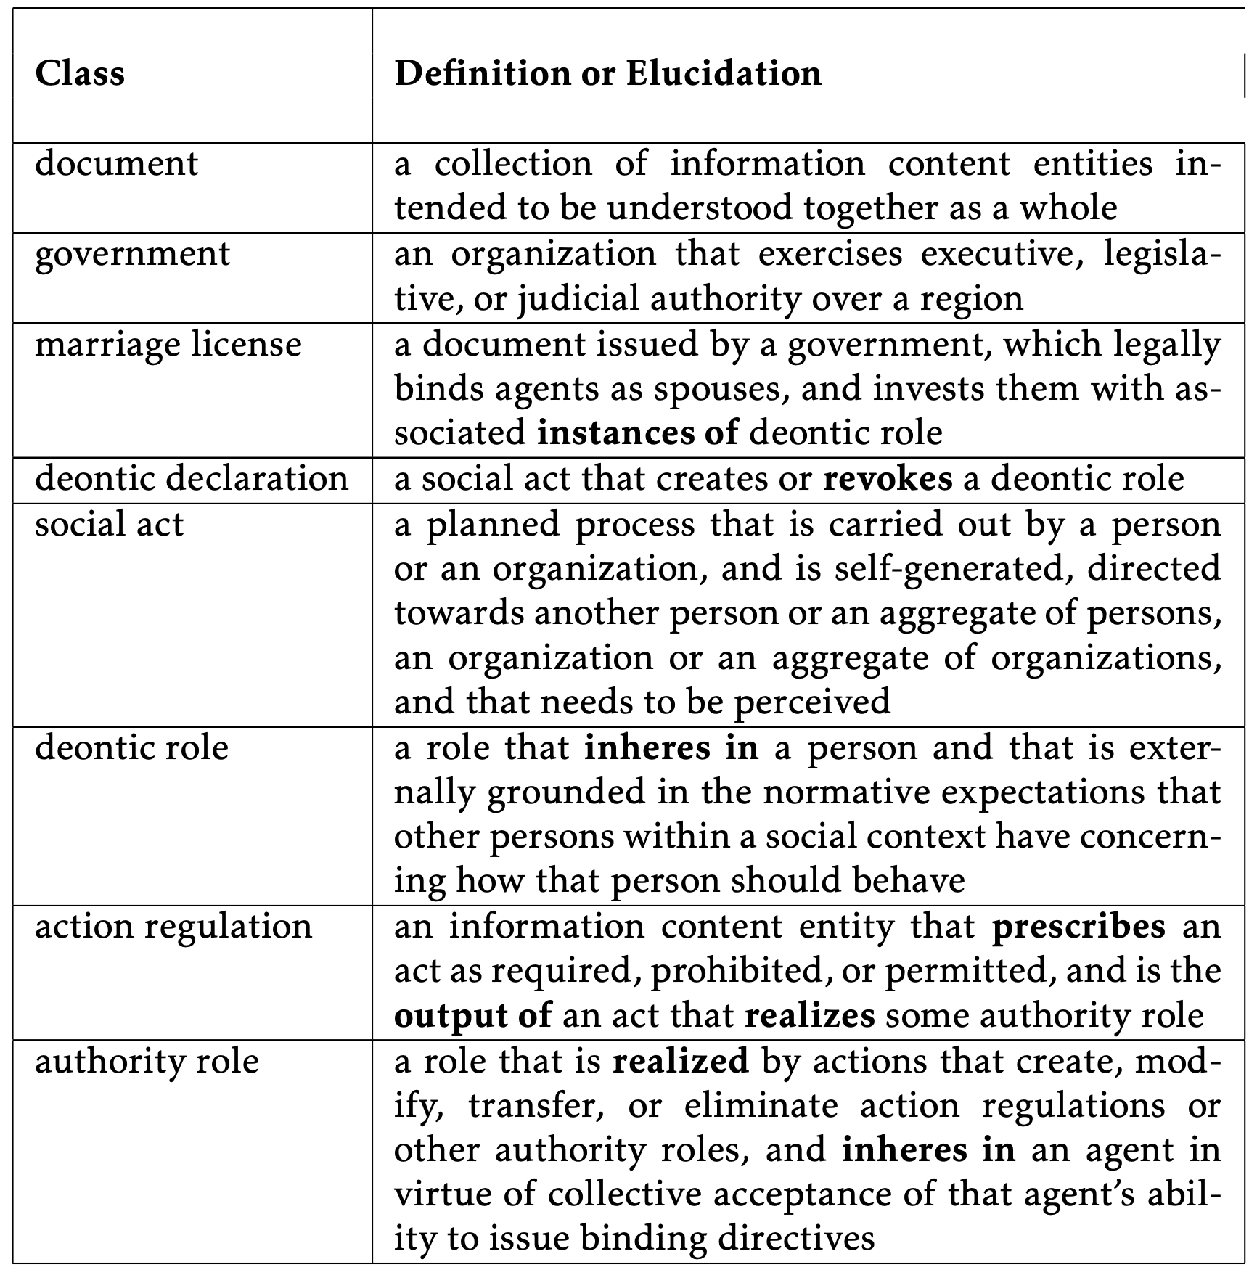
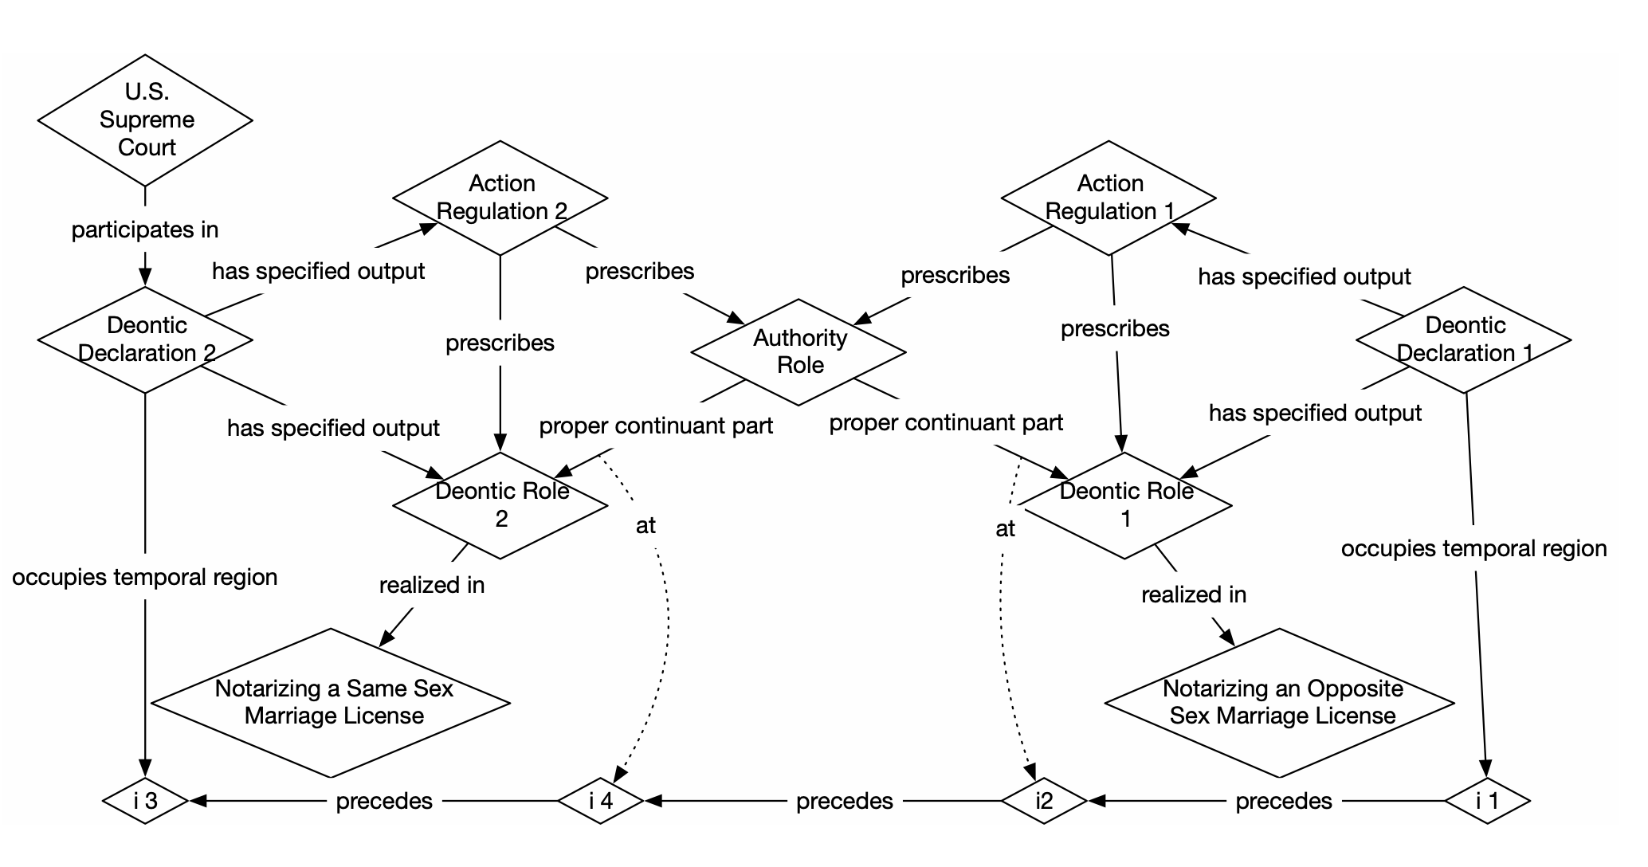

Slide 83
Readings
Aboutness: Towards Foundations for the Information Artifact Ontology
Document Acts
On Credentials
Ontology of Information Artifacts in the Intelligence Domain

